Slide 1
SIFT - Scale Invariant Feature Transform
Vishwajeet Bhosale

Slide 2
Why SIFT?
Basic template matching does not work well with variance in rotation, scale and illumination
Also with occlusion and viewpoint change
SIFT (Scale Invariant Feature transform)-
Published by David Lowe in 1999
61k citations
UBC patented it (expired last year)

Slide 3
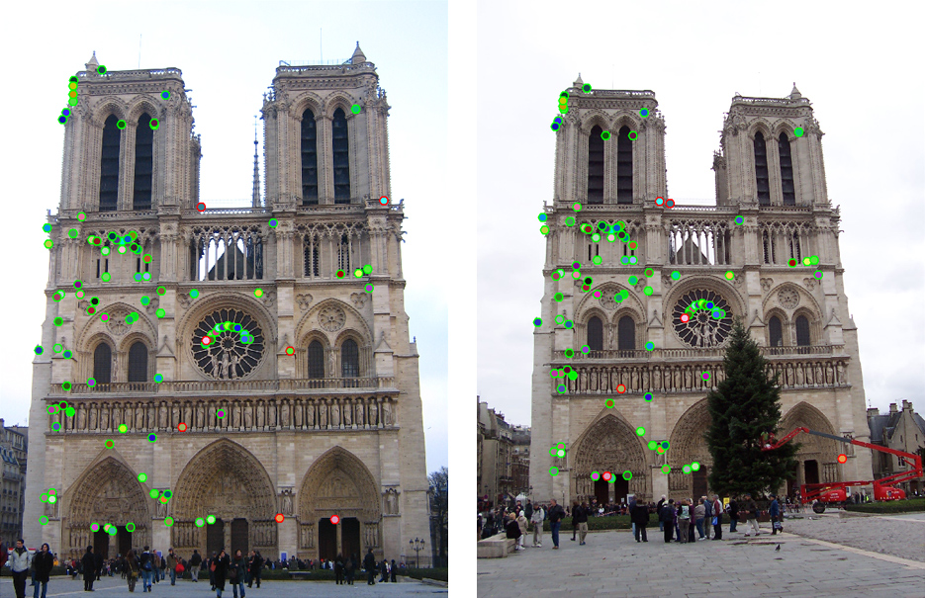
SIFT in a nutshell
K <x,y,sigma(scale), orientation, descriptor>
Image credit - https://www.cc.gatech.edu/classes/AY2016/cs4476_fall/results/proj2/html/sshah426/index.html

Slide 4
Steps
Scale Space Extrema Detection
Keypoint Localization
Orientation Assignment
Keypoint Descriptor

Slide 5

Scale Space
Objects in the world appear in different ways depending on the scale of observation
Topic explored by - Witkin (1983), Koenderink (1984) and Lindeberg (1994)
Image credit - https://staff.fnwi.uva.nl/r.vandenboomgaard/IPCV20162017/LectureNotes/IP/ScaleSpace/index.html

Slide 6
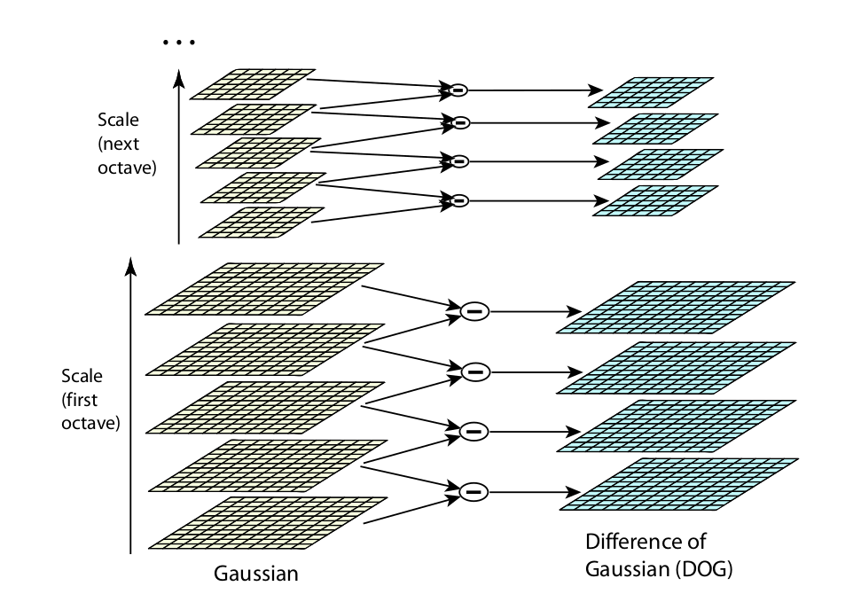
Scale Space (DoG)
D. Lowe, Distinctive image features from scale-invariant keypoints, IJCV 60 (2), pp. 91-110, 2004

Slide 7
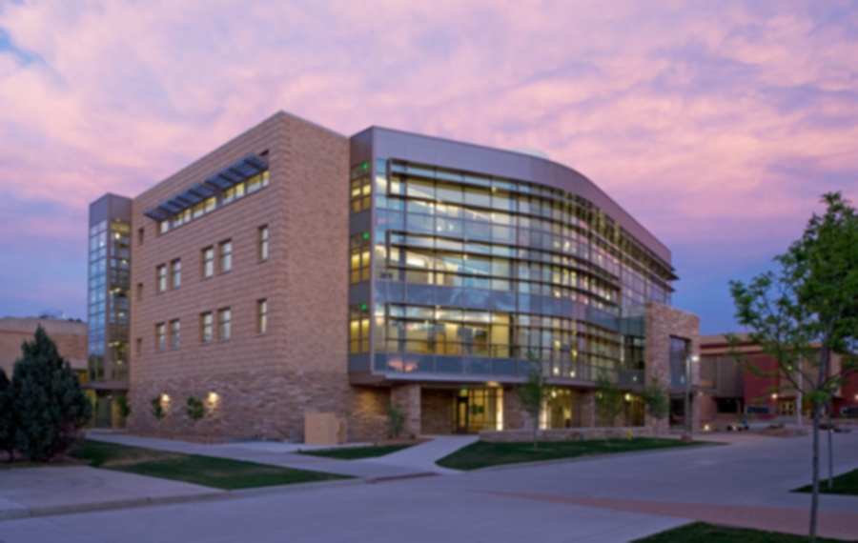
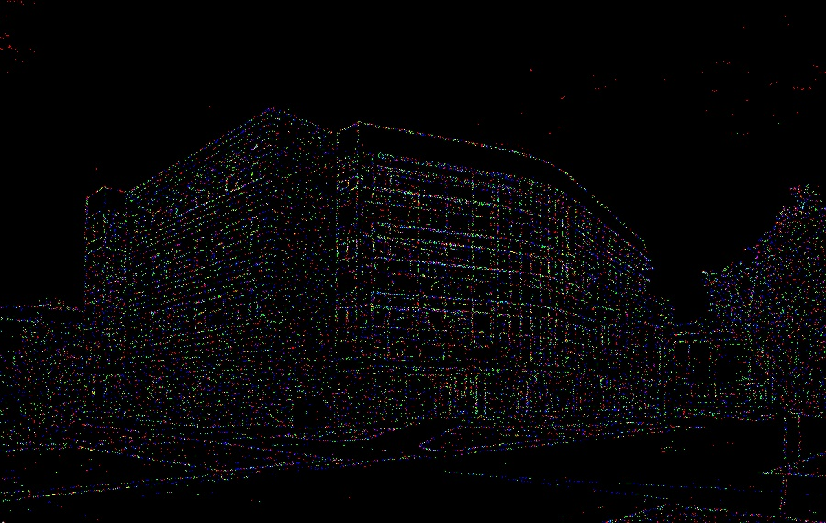

Scale Space (example)

Slide 8
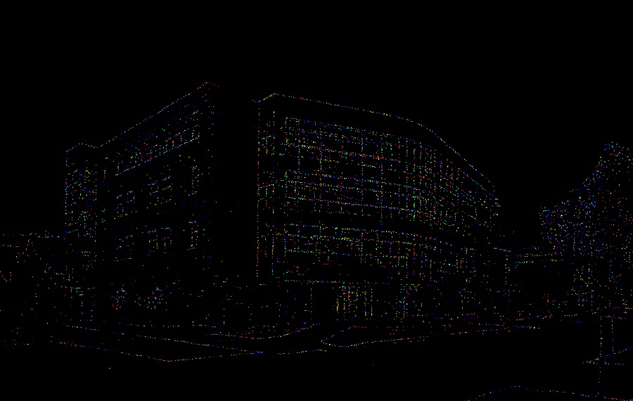

Scale Space (example)

Slide 9
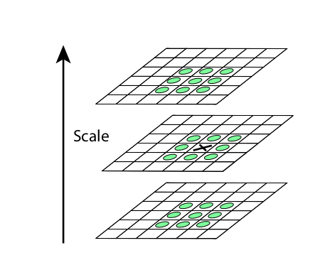
Step 2 - Keypoint Localization (Local extrema detection)
D. Lowe, Distinctive image features from scale-invariant keypoints, IJCV 60 (2), pp. 91-110, 2004

Slide 10
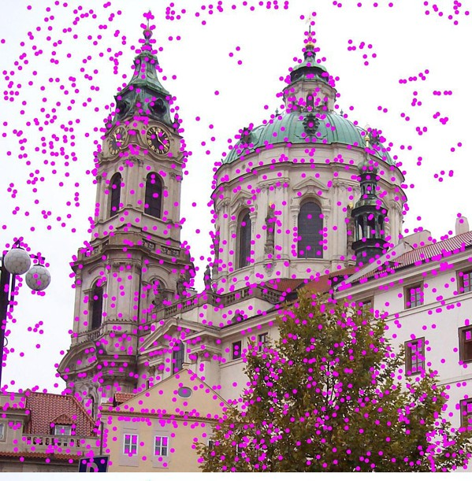
By Lukas Mach at English Wikipedia, CC BY 3.0, https://commons.wikimedia.org/w/index.php?curid=11510369

Slide 11
Step 2 - Keypoint Localization (Refinement)
What we want -
Blobs
Corners
What we don’t want -
Edges (Hessian)
Low contrast points (hardcoded threshold)

Slide 12
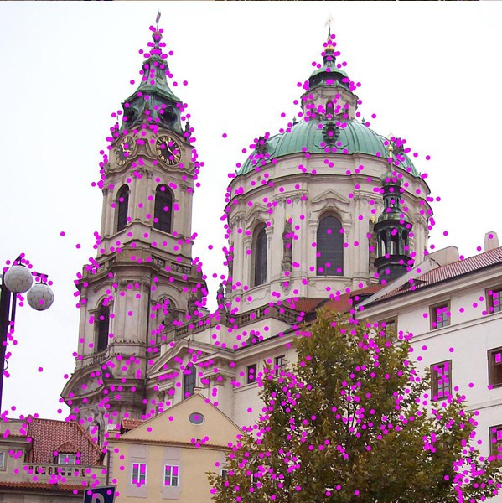

Slide 13
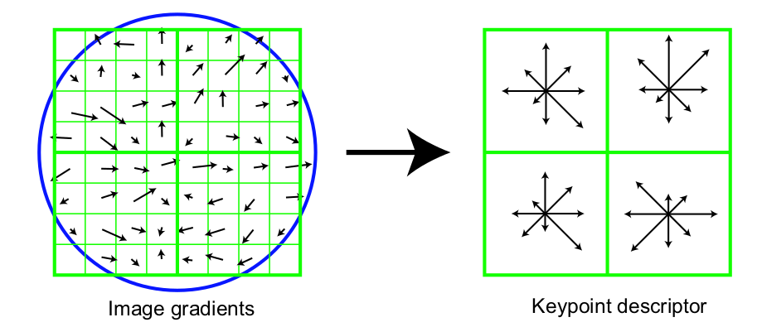
Step 4 - Keypoint descriptor

Slide 14
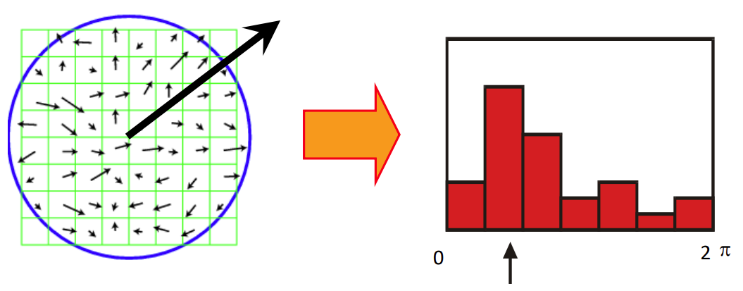
Step 3 - Orientation Assignment

Slide 15
Application (Object recognition)
Process flow -
Extract keypoints and descriptors from new image
Calculate euclidean distance between k_new - k_old
Index nearest neighbors -
Best-bin-first (BBF)
Eliminate false matches (k1_dist / k2_dist)
Cluster the keypoints using Hough Transform

Slide 16
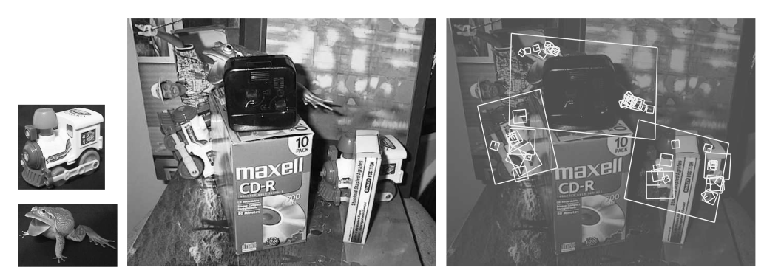
Application (Object Recognition)
D. Lowe, Distinctive image features from scale-invariant keypoints, IJCV 60 (2), pp. 91-110, 2004

Slide 17
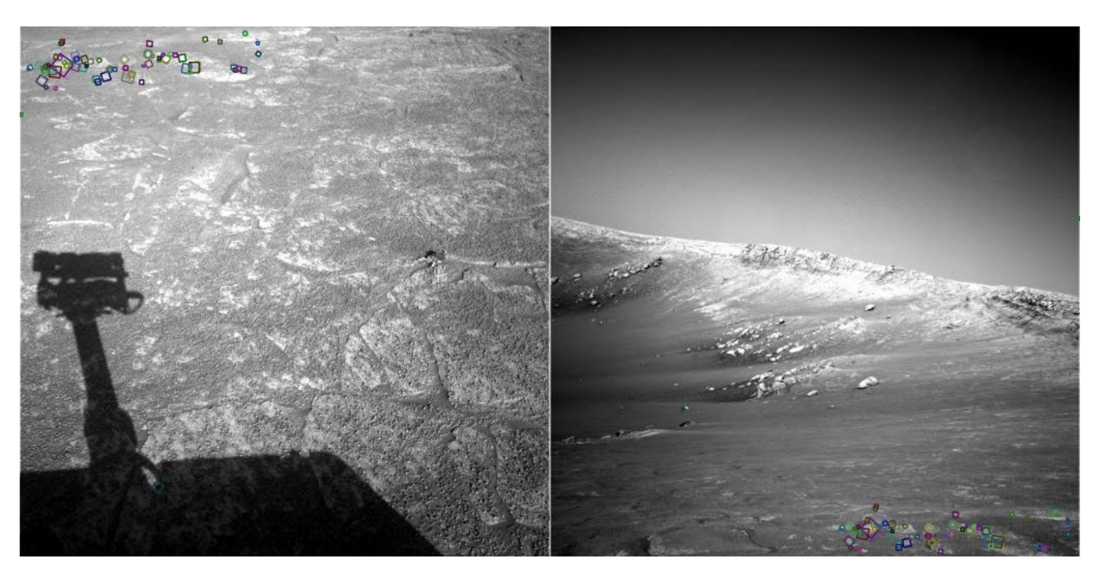

Slide 18
Other Applications
Tracking
Image blending (Panorama)
Mapping & navigation
Localization

Slide 19
Conclusion
It is modular
Still relevant in the age of NNs
Multiple variants like RIFT, SURF inspired from it
Critique of the paper
It has 25 pages but still required a lot other resources to understand the concepts and working

Slide 20
References and Useful Resources-
[1] Lowe, D.G. Distinctive Image Features from Scale-Invariant Keypoints. International Journal of Computer Vision 60, 91–110 (2004)
[2] A. Witkin, "Scale-space filtering: A new approach to multi-scale description," ICASSP '84. IEEE International Conference on Acoustics, Speech, and Signal Processing, San Diego, CA, USA, 1984, pp. 150-153, doi: 10.1109/ICASSP.1984.1172729.
[3] Ives Rey Otero, and Mauricio Delbracio, Anatomy of the SIFT Method, Image Processing On Line, 4 (2014), pp. 370–396
[4] http://www.cs.umd.edu/~djacobs/CMSC426/Blob.pdf
[5] https://slazebni.cs.illinois.edu/spring19/lec09_sift.pdf
[6] https://aishack.in/tutorials/sift-scale-invariant-feature-transform-scale-space/
[7] http://cs.haifa.ac.il/hagit/courses/ip/Lectures/Ip11_MultiscaleRepx4.pdf
[8] https://www.youtube.com/watch?v=oT9c_LlFBqs
[9] https://github.com/rmislam/PythonSIFT

